Slide 1
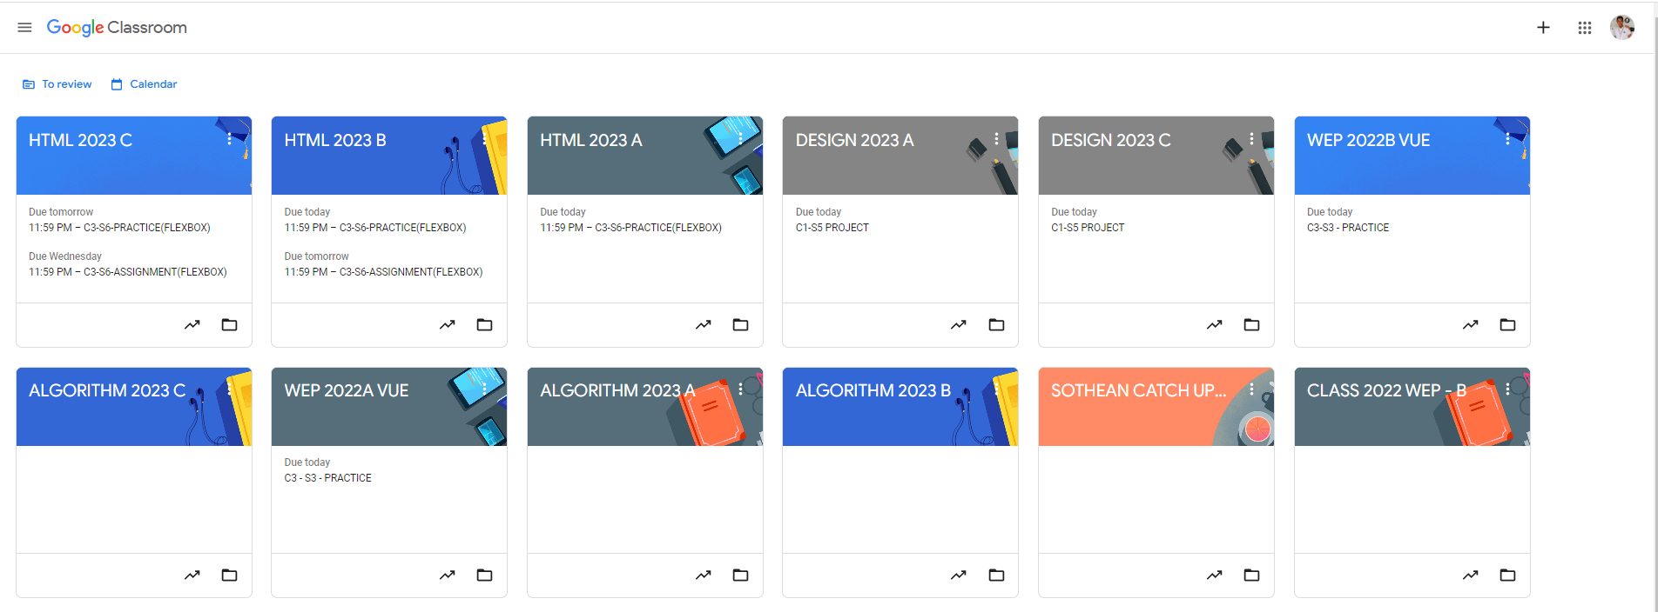
Identify root components of website below

Slide 2
Header_left
Header_right
Header

Slide 3
Header_left
Header_right
Header
Nav_left
Nav

Slide 4
Header_left
Header_right
Header
Nav_left
Nav
Main_content

Slide 5
Header_left
Header_right
Header
Nav_left
Nav
box1
box2
box3
box4
box5
box6
box7
box8
box9
box10
box11
box12

Slide 6
Main
box
Name subject

Slide 7
Main
box
Name subject

Slide 8
Main
box
Name subject

